Slide 1


SAP Analytics Cloud Training
Anubhav Oberoy

Slide 2

DISCLAIMER
The training content and delivery of this presentation is confidential, and cannot be recorded, or copied and distributed to any third party, without the written consent of Anubhav Trainings.

Slide 3

Introduction

Slide 4

LEARNING OBJECTIVES
At the end of this session, you will be able to:
Introduction to SAP Terminologies and Analytics Cloud
- Difference between Cloud and OP systems
- Cloud Offerings
- Introduction to SAP Cloud Platform
- Difference between HANA and S/4HANA
- How ERP and BW are used today
- What are all other SAP Solutions used in industry
- What is SAP Analytics Cloud
- History of SAC
- SAC Strategy
---Break---

Slide 5
LEARNING OBJECTIVES
At the end of this session, you will be able to:
System Walk Through
SAC Architecture
Compare SAC with others
Embedded Content
References
System Walk over
Guidance on SAC Certification
Create a simple dashboard on Covid-19

Slide 6
WHAT IS ON-PREMISE AND CLOUD?
An on-premise software requires following
1
6
Hardware to be purchased
Hire professionals to maintain system and get development done on top
2
7
Networking to be setup
Every upgrade and new patch needs to be applied
3
8
License to be bought by the vendor by paying lump-sum
Initial investment is very high
4
9
Hire people to manage that software
Scalability is difficult to achieve
5
e.g. outlook, SAP BW, SAP BO, SAP BPC, SAP ECC, SAP Business Suite, SAP S/4HANAOP (large corp) 8
Install all OS and manage network

Slide 7
WHAT IS ON-PREMISE AND CLOUD?
Cloud Solution
1
5
No upfront hardware investment, rather we can rent HW
Pay per user or use – subscription (multi-services)
2
No need to hire skill to manage the HW – NW, OS
6
Scalability is easier
3
7
Software upgrades are automatic hence its vendor responsibility to upgrade
Lower TCO, quality is service provider’s responsibility
4
Faster innovation (3 months)
e.g. Gmail, Netflix, S/4HANA Cloud, SAP Analytics Cloud (SaaS) - SAC

Slide 8
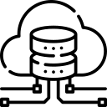


WHAT DOES CLOUD OFFERS?
SAP Cloud Platform Data centers
GCP, SCP (SAP Cloud Platform)
SaaS
SAC, Gmail
PaaS
DB,Prog,FS,Conn,Tools
IaaS
HW,OS,NW,Base
SAP, Uber, Ola, Oyo, Amazon.com
AWS, GWS, Alibaba, Azure
Digital ocean

Slide 9
WHAT IS SAP BTP (Business Technology Platform)?
If I am a startup software co. I can design, develop, test, host and deliver an complete software on SAP Cloud platform with available tools and services.
https://help.sap.com/doc/aa1ccd10da6c4337aa737df2ead1855b/Cloud/en-US/3b642f68227b4b1398d2ce1a5351389a.html
AWS – what used as IaaS to get the SAC service on cloud.
SAP Cloud platform is a Platform as a service for companies who like to build solutions on top of the cloud.
SAP Analytics cloud solution which is individual product of SAP is already built by SAP-on-SAP Cloud platform.
SAP Cloud platform user infrastructure provided by AWS, GCP, Azure and Alibaba.
Private and Confidential
9

Slide 10
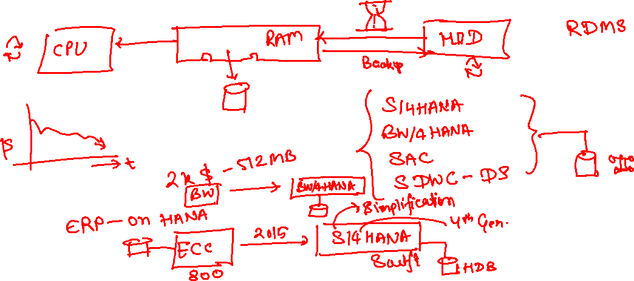
WHAT IS HANA AND S/4HANA?
HANA – Stands for High Performance Analytical Appliance. It is SAP’s in-memory DB. It keeps all data in RAM. Combination of HW and SW.

Slide 11
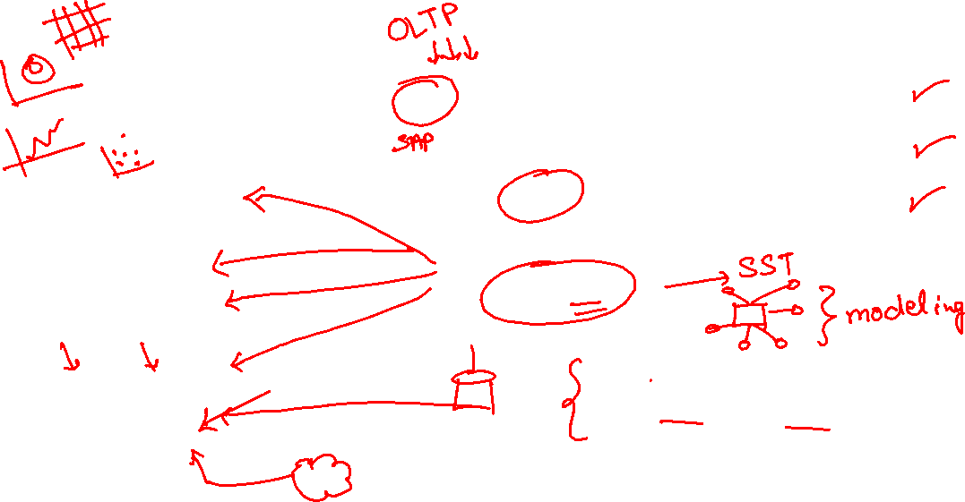
HOW DIFFERENT SOLUTIONS WORK?
Miami
Kings County
Santa Clara
ERP
NYC
ORAFIN
BAAN
BAAN
SAPBI
ETL
Salesforce
SAP BW
SAP BOBJ
SAP Lumira
Power BI/ Tableau
OLAP
Online Analytical processing
SAP Analytics Cloud

Slide 12









WHAT IS SAP BW, BOBJ & BPC?
BW – Business Warehouse system which bring all data together using ETL from different Data sources
Both Co-exist and depends on Use cases, what does a co. want.
All are on-premise solutions
BOBJ – Data mining and Business Intelligence solution offers BI capabilities
SAC – SAP Analytics Cloud – All-in-One – Cloud Based
SAP – 65% world GDP, 300mn active customer, 80k partners
BPC – Business Planning and Consolidation system for Financial, HR, etc. planning scenarios
BI | Predictive | Planning | Application Design | more..
75% beer, 65k jet, 70% oil, 62% chocs, 350Bn per day

Slide 13

WHAT IS SAP ANALYTICS CLOUD?
Is a Software-as-a-Service (SaaS) is an independent SAP product.
It allows Business Users / CIOs/ Decision Makers to take informed and confident decision.
Decision Making = Based on past Data - BI
Confident Decision = Insight (experiences) – Turn into action – ML
SAC enables the intelligent enterprise by providing everyone with insight to make confident decisions and actions immediately. A solution which is
Complete – It’s a single solution for BI, Planning, Prediction and App design
Contextual – Turn our insight to actions in context of data
Confident – usage powerful AL-driven insights w/o any ML knowledge.

Slide 14

HISTORY OF SAP SAC?
1
Mid 2013 – Project Orca
2
2014 – SAP Cloud for planning
3
2015 – SAP BOBJ Cloud
4
2017 – SAP Cloud for Analytics
5
2019 – SAP Analytics Cloud

Slide 15

SAC STRATEGY - PRINCIPLES OF CONVERGENCE
We are converging USE CASES not FEATURES and FUNCTIONS
No Force Migration
Exception:
SAP BOBJ explorer, SAP BOBJ Dashboard – Dec 2020 – ADOBE Flash technology
SAP BOBJ Desktop Intelligence – Dec 2018

Slide 16
IMPACT ON EXISTING SOLUTION – BI STRATEGY
SAP SAC
SAP BOBJ explorer Rombi
Lumira Desktop and Discovery
BOBJ Analysis for OLAP
01
SAP Lumira 2.x – by 2024
After must move to SAC
SAP Crystal Reports (BOBJ) SAP SAC
02
Dashboard and App Design BOBJ Designer Studio Bex WebApp Designer BOBJ Dashboard
04
Reporting
Desktop Intelligence
BOBJ Set Analytics
03
Analysis for Office
Office Integration
Live Office
EPM Add-in
Bex Analyzer

Slide 17


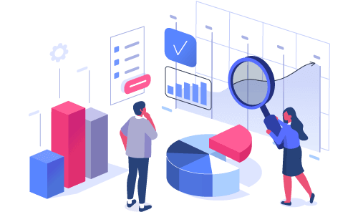
IMPACT ON EXISTING SOLUTION – PLANNING STRATEGY
Planning
Business Planning & Consolidation system (BPC)
On-premise
SAP S/4HANA for standalone planning along FIN
BPC – On-premise planning
Cloud
SAC – Stand along planning
Consolidation
Business Planning & Consolidation system (BPC)
On-premise
SAP S/4HANA group reporting functionality
BPC – On-premise planning

Slide 18
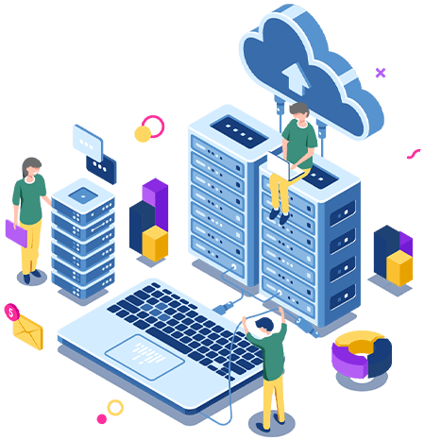

IMPACT ON EXISTING SOLUTION – PREDICTION
SAP Data Intelligence is a solution which On-premise and allows us to create models and apply them on dataset to get prediction. Going forward all the developments related to this since 2018 were channelized to SAC.
Together with all of it, SAP introduced a state of art app builder called Application Layer.

Slide 19


WHY SAC IS IMPORTANT AS COMPARE TO OUTSIDE MARKET
Bi – Business Intelligence – Tableau (Salesforce 15.7Bn), Power BI, QuickTech
Planning – Hyperion, Apaplan
Predictive – Watson, SAS
Application Designer – UI5 & Fiori, Android, Angular, React etc.
SAC – Can cover all above scenarios.

Slide 20
HOW SAC IS ADVANCED FROM ITS COMPETITOR
CAPABILITIES | SAP – SAP ANALYTICS CLOUD | ORACLE (OAC) | MICROSOFT (Power BI) | THOUGHTSPOT* needs updating | WORKDAY (Adaptive Insights + Prism Analytics) | ANAPLAN | SALESFORCE + TABLEAU
All analytics on one cloud native platform: BI, planning, augmented​ analytics |  |  |  |  | Not in one platform |  | (no planning)
Live connection to on-premise data sources without moving the data to cloud​
Pre-built industry and line-of-business content, built by the vendor and its partners​
Hybrid analytics: offering on premise and cloud that work together​ |  |  |  |  |  |  | (Acquired through Tableau)
Has this capability | Has some of this capability | Does not have this capability

Slide 21
HOW SAC IS ADVANCED FROM ITS COMPETITOR
CAPABILITIES | SAP – SAP ANALYTICS CLOUD | ORACLE (OAC) | MICROSOFT (Power BI) | THOUGHTSPOT* needs updating | WORKDAY (Adaptive Insights + Prism Analytics) | ANAPLAN | SALESFORCE + TABLEAU
Embedded machine learning in business applications with process and workflow with semantics and business logic​
Board and C-suite analytics with large touch screens display UX with SAP Digital Boardroom​
End-to-end data management and analytics capabilities that work seamlessly together ​
Planning and analysis embedded with ERP​
Has this capability | Has some of this capability | Does not have this capability

Slide 22


SAP SAC ARCHITECTURE
Applications
SAP Digital Boardroom SAP Analytics Hub Mobile Experience
SAP App Center
BI
Discovery
Charts and tables
Geospatial
Planning
Events and workflows
Allocation
Value driver tree simulation
Predictive
Smart Assist
Build & deploy predictive models
Application Design
Scripting
Composites
UI theme & stylesheet
Embedding
Analytics into applications
Analytic Capabilities
Core Capabilities
Data connectivity
Wrangling
Modeling
Administration Auditing
Visualizations
Collaboration
Mobile
APIs
PaaS
SAP Cloud Platform
Amazon Web Services
SAP Data Center
Cloud data sources
and applications
On-premise data sources and applications

Slide 23
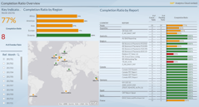
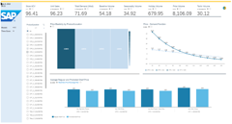
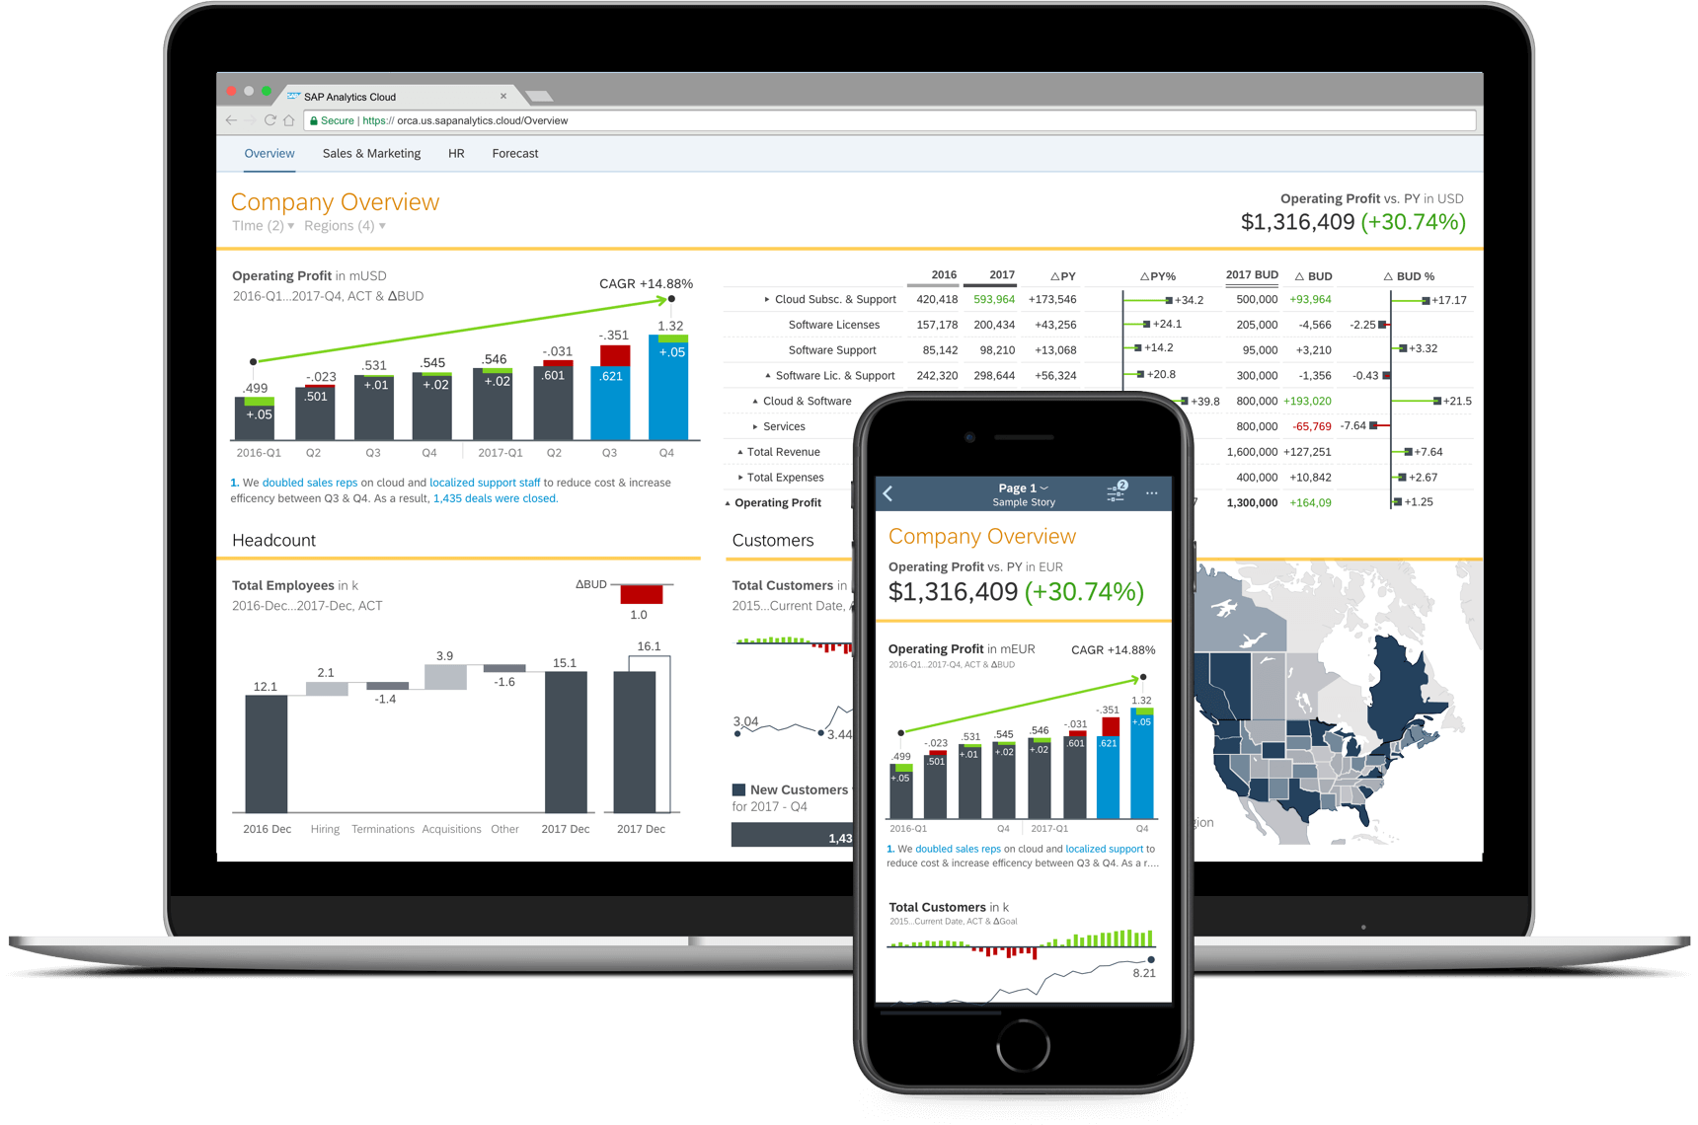
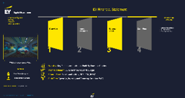
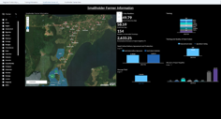
EMBEDDED STANDARD CONTENT
72 Packages by SAP
65 Packages by Partners
SAP S/4HANA
SAP C/4HANA
SAP SFSF
SAP Concur
SAP Ariba
etc..
SAP data sources
Non-SAP data sources
Accelerate your Enterprise Analytics projects with pre-built analytics from SAP and our Partners

Slide 24
BUSINESS CONTENT DELIVERED BY SAP
Line of Business
Goods and Services Tax GST Analytics
Human Resources (SuccessFactors)
Human Resources (SuccessFactors) – Simplified Chinese Localization
Human Resources (SuccessFactors) (BPE)
Human Resources Salary Planning
Intelligent Asset Management
Integrated Financial Planning for SAP S/4HANA
Liquidity Planning for SAP S/4HANA Cloud
SAP Marketing
Manufacturing S/4HC (BPE)
Procurement
Procurement for SAP S/4HC (BPE)
Product Cost Planning
Advanced Compliance Reporting
Business ByDesign (Finance and Procurement)
Environment, Health and Safety
Field Service Management
Finance
Finance Account Receivable – Invoice Payment Forecasting.
Finance Contract Accounts (FI-CA)
Finance – Live based on Semantic Tags
Financial Consolidation for SAP S/4HC Cloud (BPE)
Financial Planning & Analysis for SAP S/4HANA Cloud
FI Operational Expense Planning
Project and Portfolio Management
Project Budgeting & Planning S/4HC (BPE)
Project Staff Planning
Receivables Management for S/4HANA Cloud (BPE)
SAP Finance – Contract-based revenue recognition (CBRR)
SAP Financial Products Subledger IFRS17 for S/4HANA (New)
SAP Integrated Business Planning
SAP Intelligent Asset Management
SAP Qualtrics - Customer Satisfaction Score
SAP Qualtrics - Survey distribution and Analysis
SAP Supply Base Optimization
Further information can be found in the following blog

Slide 25
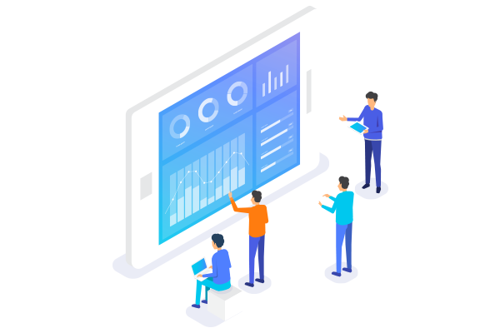
BUSINESS CONTENT DELIVERED BY SAP
Line of Business
SAP S/4HANA for Financial Products Subledger – Reporting
Sales Cloud for SAP S/4HANA (BPE)
Sales Performance and Target Planning (CRM)
Sales Cloud for SAP S/4HANA Cloud (BPE)
SAP Sales Planning for SAP S/4HANA Cloud
Service Cloud Analytics (CRM)
Solution Manager: Test Suite Analysis
Solution Manager IT Service Management Analytics
Sports One Analytics
Sports One Analytics (German)
Trade Management
Travel & Expense – Concur
Treasury Management
Vendor Management System (Fieldglass)
Workforce Planning for S/4HC (BPE)
Further information can be found in the following blog

Slide 26
BUSINESS CONTENT DELIVERED BY SAP
Industry
Agriculture Origination, Trading and Risk Management (New)
Banking
Chemicals
Consumer Products
Customer Profitability Analysis
Engineering, Construction, & Operations
Health Care
High Tech (New)
Industry Innovation Kit – Leonardo Zero Waste
InsuranceMill Products
Mining
Oil & Gas
Professional Services S/4HC (BPE)
Public Sector
Public Services: Higher Education and Research
Real Estate
Retail (Model Company Fashion for Vertical Business)
Retail (Model Company Core Retail)
Retail (Omnichannel Article Availability and Sourcing)
Rural Sourcing Management
Utilities
Further information can be found in the following blog

Slide 27
BUSINESS CONTENT DELIVERED BY SAP
Packages that include Planning
Banking
Chemicals
Finance
Financial Planning & Analysis S/4HC (BPE)
FI Operational Expense Planning
High Tech
Human Resources Salary Planning
Integrated Financial Planning for SAP S/4HANA
Liquidity Planning for SAP S/4HANA Cloud (BPE)
Oil & Gas
Product Cost Planning
Project Budgeting & Planning S/4HC (BPE)
Project Staff Planning
Sales Performance and Target Planning (CRM)
Sales Planning for SAP S/4HANA Cloud (BPE)
Travel & Expense (Budget Planning)
Workforce Planning for SAP S/4HC (BPE)
Further information can be found in the following blog

Slide 28

REFERENCES
x
SAP Analytics Cloud Product Roadmap
SAP Analytics Cloud Help Documentation
SAC Webinars
Help Library
Free learning videos
What’s new with SAP SAC
SAC YouTube Playlist
SAC Admin guide for Live connection
https://www.sapanalytics.cloud/plans/
Register for your SAP SAC Server
https://blogs.sap.com/2019/06/24/webinar-summary-sap-bi-roadmap-update-with-saps-patrick-sims/

Slide 29

System Walkthrough

Slide 30
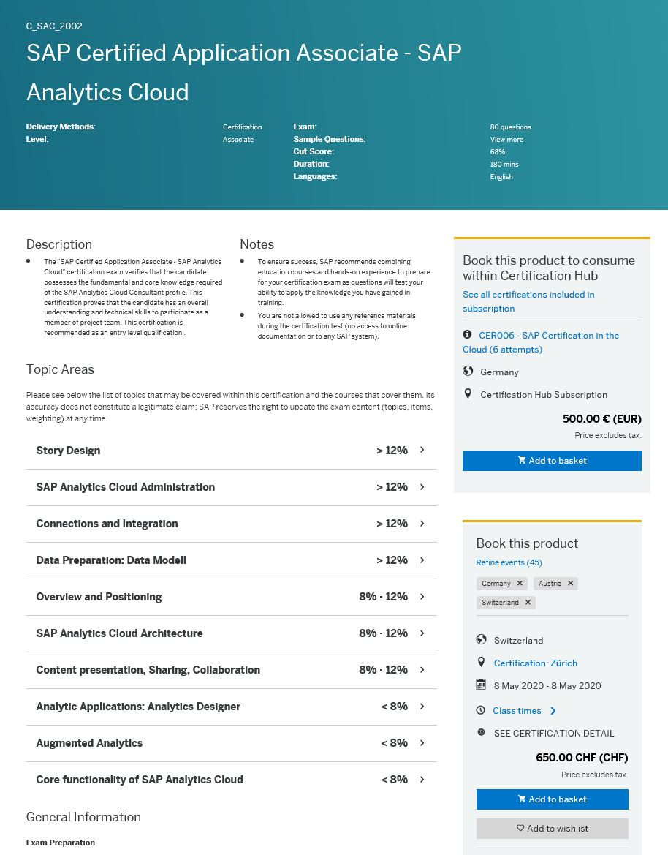



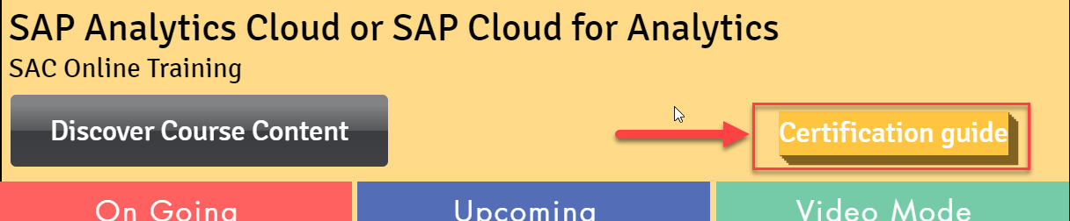
SAP ANALYTICS CLOUD CERTIFICATION – C_SAC_2302
One SAP Analytics Cloud Certification (SAP Certified Application Associate - SAP Analytics Cloud) was rolled out in December 2019. This certification proves that the candidate has an overall understanding and technical skills to participate as a member of project team.
Certification Hub Subscription : 500 € (EUR)
CER006 - SAP Certification in the Cloud (6 attempts)
https://www.anubhavtrainings.com/analytics-cloud-training

Slide 31

EXAMPLE USE CASE
You are working as Sr. Healthcare officer at WHO. Your job is to understand the on-going pandemic and its infection spread across countries. We want to understand the country wise cases and spread curve on timeline.
Dataset is available here

Slide 32

FEEDBACK

Slide 33


We’re committed to empower you to be
#FutureReady
through powerful training solutions.
We build the workforce of the future.
250+
Corporate Clients
30,000+
Learners Trained
25000+
Learners Placed
FREE WEBINARS
Sign up for free webinars with industry experts every fortnight!
Enroll Now!
Contact us today!
www.anubhavtrainings.com

